Slide 1


/
Location-Based Upsell
Java Academy 2020 - Project Business Aspect

Slide 2
Project Topics
Introduction -> koe
Benefits of the project -> rci
File Processor -> iaj
Event Processor (Engine) -> pin
Sms Gateway -> gku
Conclusion -> mlb

Slide 3
Introduction
Location Based Upsell
The main idea behind the idea is to target a subscriber with a promotional SMS based on his location enabling the companies in upselling there packs to the users.
Some More About Location based Upselling:
Reaching consumers in the right place at the right time with the right message and experience.
Content, media and services adapted to an individual’s current physical location.
Powered by technologies such as SMS, GPS, RFID, WiFi, Near Field Communication, iBeacon.

Slide 4
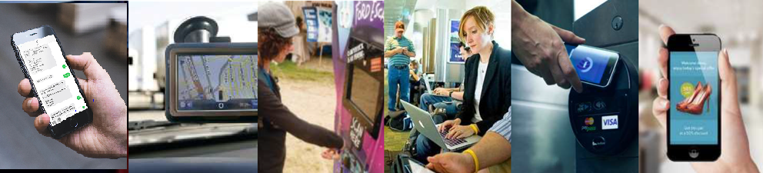



Key Technologies enabling location based upselling
RFID
WIFI
NFC
iBeacon
SMS
Most common wireless technology exchange for connecting devices to the Internet using radio waves. Offers high speed longer range access and bandwidth
Small electronic chips that transmit data wirelessly via radio- frequency identification. Similar to a barcode (unique object identifier)
Establishes short-range communication between devices by touching or bringing them into proximity.
Enables an iOS device or other hardware to send push notifications to within close proximity.
SMS is a text messaging service component of most telephone, Internet, and mobile device systems
Space-based satellite navigation system that provides accurate location information to GPS-enabled devices.
Near Field Communication (NFC) can be used for cashless payments (i.e. Google Wallet). NFC tags can also be embedded into non electric objects or media (such as posters) to create interactivity with consumers.
Placed in strategic locations, sends mobile alerts with info, coupons or rewards
to consumers when they approach a certain area.
Used in most navigation systems and mobile phones to provide directions or locate and target the consumer with customized content.
RFID tags can identify and track movement (of objects, products, people). At events, consumers can check-in in a venue just by wearing a RFID bracelet.
It’s the preferred technology to engage consumers with apps, websites, or other digital content.

Slide 5

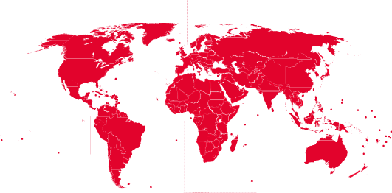

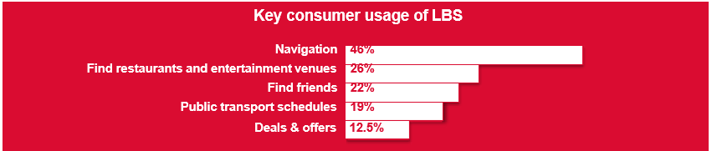
Location-based consumer usage throughout the World
Find restaurants &
Entertainment
Venues
Find friends
Navigation, Safety, Emergency & Tracking

Slide 6
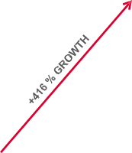
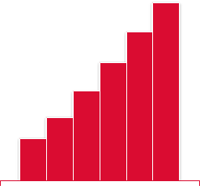
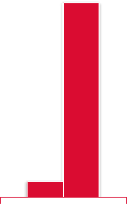

Location-based Marketing: Growth & Spend
Significant growth in both the number of people using Location-based Services and the marketers’ investment in Location-based Marketing media.
Location-Based Services
Worldwide Users
2014-2019 (millions)
Location-Based Advertising & Marketing Spend
Worldwide, 2012-2017 (€ billions)
Almost 20% of the world population is already using LBS. 62% of those who don’t, aspire to do so in the future.
Location-based services are expected to bring in $250 billion in revenue from consumers and advertisers by 2020 More than 50% will come from location based search advertising.
€ 0.53
2014 2015 2016 2017 2018 2019
2012 2017

Slide 7
Benefits of text marketing campaigns
Build loyal customers
Sms Marketing is a great channel to engage and build loyal customers. Offer your customers promotions and offer informations about your business when you feel the need. This makes you customers feel appreciated by keeping them the main focus of your business. The more you give, the more you get back.
Fast and Effective
Sms Marketing allows you to reach a large number of people all at the same time. Text Messaging is an instant marketing tool, getting your message into the hands of the right audience, when you want it. Customers keep their mobile phones on hand, making it easy to communicate your message to them.

Slide 8
Benefits of text marketing campaigns
Straight to the point
With only 160 characters allowed when sending a text message this ensures that your message is clear and concise. Getting straight to the point is important, telling customers exactly what you want them to know and making it an easy read will benefit both the customer and your business.
Time management
Everybody knows that ‘Time is Money’, with SMS Marketing you will save a lot of time, allowing you to concentrate on other areas of the business. It is a simple and easy process. With the scheduling component of SMS you can simply organise your SMS marketing campaigns for a later date. This is a huge benefit as it allows you to manage your time efficiently.

Slide 9
File Processor
The key part in finding customers to whom we can upsell products is to localize them.
We do that through voice call records provided by the phone operator.
This records are stored in cdr(call detail record) file format. File processor extracts all the information from these files which are stored somewhere on the disk (supposedly, they are in an input directory)
File format:
H|<filename>|<createdate>
R|<unique_id>|<timestamp>|<a-number>|<b-number>|<duration>|<cellid>
T|<num_recs_total>|<num_calls_to_short_numbers>|<total_duration>

Slide 10
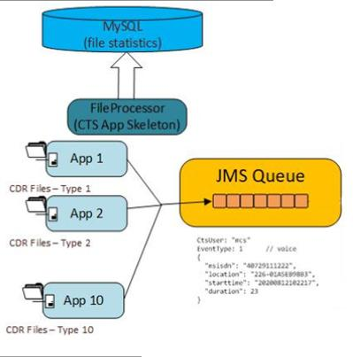
File Processor
Each record contains: the msisdn,the call’s start time, the call’s duration and most importantly the cell id which gives us the area, his location. The records are put in a jms queue in order to be further processed and selected in the engine module.
File processor also makes up statistics about files(how many records were read for each file, how many were corrupted, how many were incomplete) and puts them in a database(one record in db per file).

Slide 11
Event Processor
Event Processor is a java boot application that takes input from the JMS Queue.
The event processor helps to differentiate whether the call was made from a concert, an airport or a non interest area.
Once the area is identified it takes the phone number and checks it from the database whether the subscriber has the specific needed roaming pack or not.
If its a concert call, the message would be sent directly
If its a airport call, we check from the database if the subscriber already has a roaming pack or not. We only send messages to the ones who do not have roaming pack.

Slide 12
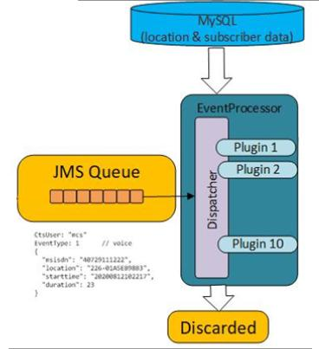
Architecture of the Engine
Input: JMS entries in Queue
Output: SMS to the subscriber
Configuration:
JMS Queue
DB Connection
SMS Gateway

Slide 13
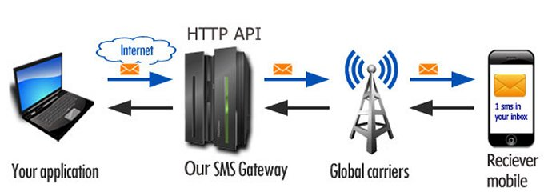
SMS Gateway
The basic function of an SMS Gateway is to send or receive SMS message to and from a SMS capable device over the network and then return a delivery report with details such as time of delivery, delivery status, etc. For sending a SMS, we need to connect to the gateway using any user interface.
Computers can interact with SMS Gateways :
Through a REST API, where software developers send and receive SMS messages over HTTP to the REST API
Features:
Report with statistics
Long messages
Message templates

Slide 14
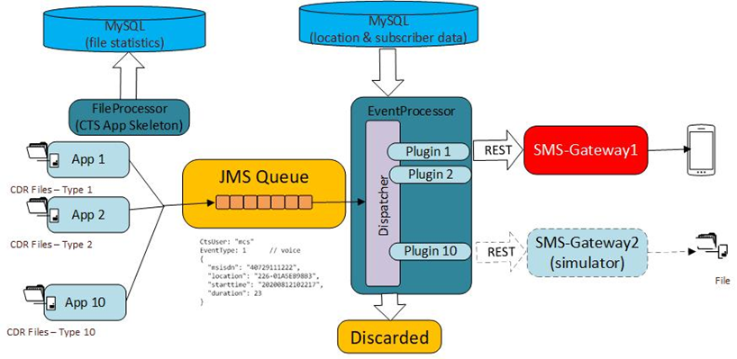
SMS Gateway
Spring Web Application (With REST microservice)
RestTemplate object is used for sending HTTP GET request for sending SMS.
Basic Authorization in HTTP request using any encoding algorithm to validate username and password.
Each SMS need to have a request body
Example: {"msisdn":"0729036998",“message":"hello world!“}
After delivery of SMS, there will be a delivery status either SUCCESS or FAILURE (with description).

Slide 16
Project Conclusion
Referring to upselling, it can be stated that this is a sales strategy that involves persuading and encouraging customers to buy more high-end, upgraded, premium or other supplement versions of a product than they originally intended to buy to earn more from a sale.
By its architectural nature, this project becomes a strategic element that a company, such as a telephone service provider, can rely on to increase its number of sales through upselling.
Implementation of a system for sending text messages that contain information about the offers and promotions that a customer could benefit from, depending on the location in which is at a time, in the modern business environment it is perfectly worth it. Here, the development of such a software product or service is strongly influenced by how things turn out. Thus sometimes we can face spikes (which can take even a lot of time to investigate and solve when problems arise), or periods when everything is blooming, and when an idea can be successfully put into practice through a line of code.

Slide 17
Project Conclusion
So the development process can be compared to a road through mountains and valleys, sometimes with high hills, other times with wide and smooth plains, at the end of which are the heights that define the victories of a programmer in today's IT world.
Thus concluding, the purpose of this project is highlighted by the help it offers to retailers when it comes to build deeper relationships with customers. based on trust and loyalty, by making the right recommendations, in a timely manner at high open rates at the right place.

Slide 18


